Slide 1

Immigration Status and Employment
Philippe Weisz
Director of Legal Services
215-832-0904/pweisz@hiaspa.org

Slide 2
Agenda
Introduction to who we are
Why are we talking about employment authorization
Who does this affect
Examples and particular challenges
Q&A

Slide 3

HIAS Pennsylvania supports low-income immigrants of all backgrounds as they build new lives in our Greater Philadelphia community.
Notes:
MUST BE INCLUDED: Include personal story here--what do you do to advance our mission. 400,000 in our 140 year history

Slide 4

Immigration Legal Services
Asylee outreach
Citizenship and family unification
Children and youth
Survivors of crime
Survivors of torture
Survivors of domestic violence
Deportation defense
Notes:
HIGHLY ENCOURAGED TO INCLUDE.
Possible words to include: As noted above, HIAS Pennsylvania provides a broad array of services to the most vulnerable in our community, from immigrant youth to those in deportation proceedings.

Slide 5

Social Services
Refugee resettlement
Education
Immigrant Wellness
Employment
Health

Slide 6
Employment Authorization: What does it mean?
In 1986, Congress passed the Immigration Reform and Control Act (IRCA).
IRCA forbids employers from knowingly hiring individuals who do not have work authorization in the United States.

Slide 7
Employment Authorization: Who is authorized?
Individuals who may legally work in the United States are:
  Citizens of the United States
  Lawful Permanent Residents
  “Aliens” authorized to work

Slide 8
Employment Authorization: What does law require?
To comply with the employment eligibility verification provisions of the INA an employer must:
  Verify the identity and employment authorization documents of employees hired after November 6, 1986
  Complete and retain a Form I-9 for each employee hired after November 6, 1986
  Refrain from discriminating against individuals on the basis of actual or perceived national origin, citizenship or immigration status

Slide 9
Employment Authorization: Who is not required to complete I-9?
Employers are not required to complete Form I-9 for:
  Domestic service employees working in a private household when work is sporadic, irregular or intermittent.
  Independent contractors for whom you do not set work hours, or provide tools to do the job.

Slide 10


Immigration Categories
Immigrant
Nonmmigrant
Citizen (USC)
· Student · Lawful Permanent Resident (LPR) ·Birthright
AKA “green card”
· Tourists Naturalization
· Temporary Workers Acquisition
· Others with limited stays Derivation
of authorization
UNDOCUMENTED
Notes:
No work permit without first qualifying for some kind of visa! WHAT IS UNDERLYING STATUS/VISA?
Ability to change status between various forms of nonimmigrant visas as well. Student 🡪 TPS 🡪 U visa 🡪 (don’t assume that someone with status doesn’t need immigration help).
Ability of gov’t to UNDO status (removal, rescission, revoking ctzp)

Slide 11
Immigrants in Pennsylvania: The Numbers
1 in 14 residents in Pennsylvania are immigrants
In 2018
  7% of the population were immigrants
    19% of the immigrant population was undocumented
  9% of the the state’s native born population was living with at least 1 immigrant family member (mixed-status families)
    See American Immigration Council

Slide 12
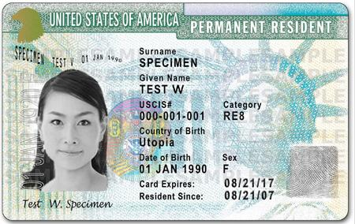
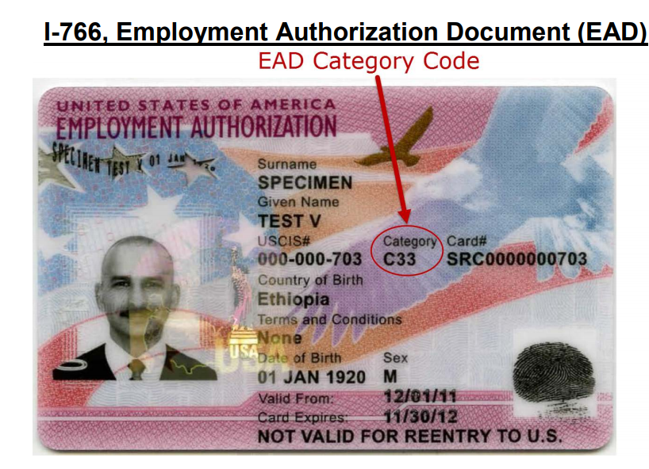
Examples of Documentation
LPR - Green Card
Work Permit - Employment Authorization

Slide 13
Complications and Challenges
Processing delays and Auto Extensions of EADs
Fear of authorities

Slide 14
Questions and where to refer individuals with immigration questions
Immigration legal resources in Pennsylvania

