Slide 1
Interviewing for the Future
Brian Cummings

Slide 2
Type of Interview Questions
Behavioral Questions- Ask the candidate almost anything about their behavior at past workplaces or in school settings. You can also present them with a specific situation and ask them to tell you what they would do.
Communication Questions-How would your co-workers describe your personality? Do you work well with other people? What are your pet peeves?
Opinion Questions- What would you do in _____ situation?” looks for a candidate’s subjective opinion on how to analyze a situation.
Performance-Based Questions-Interview questions that are performance-based focus less on a candidate’s individual behaviors and more on how they perform in the role. You could ask about a major achievement or a failure.
Brainteasers- A brainteaser question doesn’t seek the right answer. Instead, it tests the candidate’s logic, math skills, critical thinking, and creativity.

Slide 3
Examples of Interview Questions
What would you change about your previous job/employer?
What has been your biggest success so far? How did you achieve it?
What skill are you still missing?
Describe the type of coworker you find most difficult to communicate with and your strategy for effective communication.
What do you know about the company/organization?

Slide 4
Tips to Find the Right Fit
Ensure the list of qualifications are accurate
Partner with an educational institution
Model work behavior/culture
Take a tour
Include an assessment

Slide 5
Interview Plan
Who will be involved in the interview process?
How are you scoring each interview?
Looking for the top two/three candidates to move forward.
How will communication be handled post interview?
Review reference check questions.

Slide 6
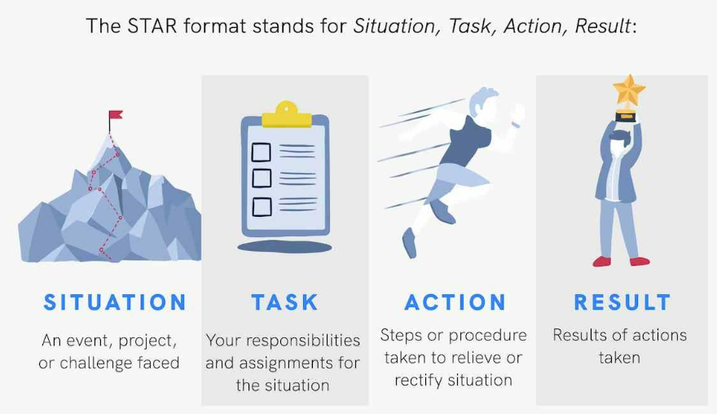
STAR Method

Slide 7

Thank You
Any Questions?

Slide 8
Contact Information
Brian Cummings
Program Manager, Economic Development | County of Bucks
Email- bcummings@buckscounty.org
Call or Text- (267)374-4773

