Slide 1
INTERPERSONAL COMMUNICATION SKILLS
GUEST SPEAKER
Scott Mognet

Slide 2
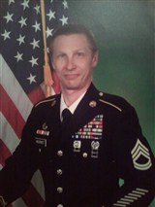
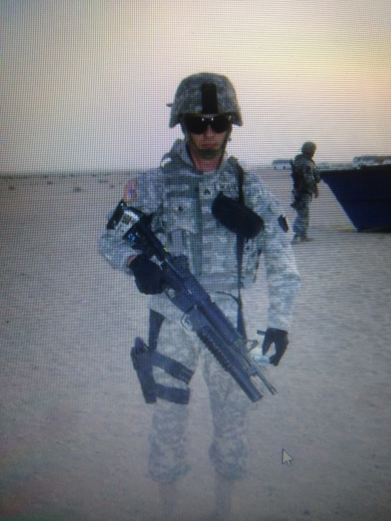
Introductions
Retired US Army Military Police Officer
Retired Federal Police Officer
Business Owner

Slide 3
Objectives
1. Define Interpersonal communication skills (IPCS)
2. list 10 key IPCS
3. The communication chain
4. list the 8 essential skills for effective communication
OODA Loop

Slide 4
What is Interpersonal Communication?
*Interpersonal communication consists of verbal and nonverbal communication.
* Interpersonal skills are a subset of soft skills, as opposed to hard skills. While hard skills relate to your on-the-job technical expertise and are learned through instruction, soft skills relate to the intangible qualities and personality traits that make you, you.

Slide 5
10 Key IPCS
1. Self-Confidence
2. Work Ethic
3. Relationship Management
4. Receptiveness to Feedback
5. Body Language
6. Listening
7. Collaboration

Slide 6
10 Key IPCS continued
8. Conflict Management
9. Positive Attitude
10. Workplace Etiquette

Slide 7
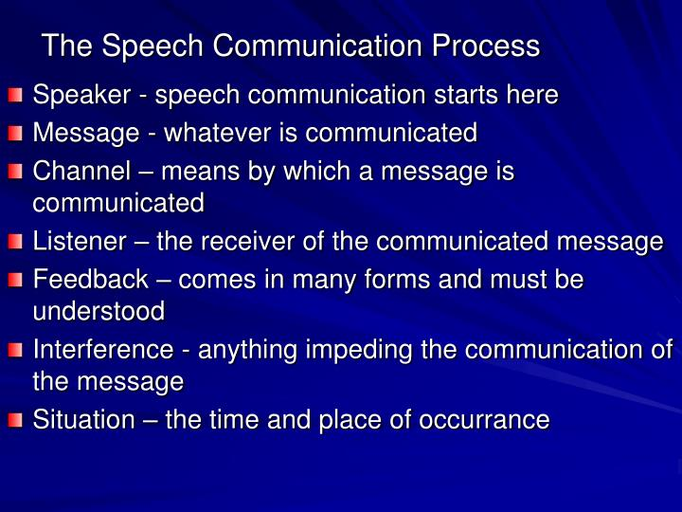
The Communication Chain

Slide 8
How to be good at talking
1. Polite greeting
2. Name
3. Relevant personal link
4. Manage expectations
Example: Hello, My name is Inigo Montoya. You killed my father, prepare to die.

Slide 9
The 8 Essential Skills for Effective Communication
Listening. One of the most important aspects of effective communication is being a good listener.
Non-Verbal Communication.
Be Clear and Be Concise.
Be Personable.
Be Confident.
Empathy.
Always Have An Open Mind.
Convey Respect.

Slide 10
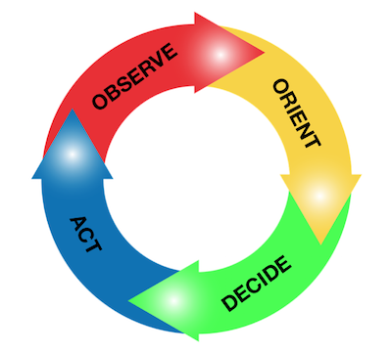
OODA Loop

Slide 11
The Origin of the OODA Loop
The OODA loop was first developed by Air Force fighter pilot and military strategist John Boyd. Boyd was best known for implementing the loop himself when engaged in combat, and later explained the process of the loop as a way of approaching any decision that needs to be made. The loop is so called the OODA loop, as an acronym representing the four stages of how we respond to stimuli.

Slide 12
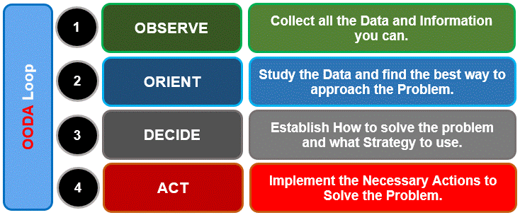
Using the Loop

Slide 13
Definitions
A supervisor: an individual immediately in line after management who is responsible for monitoring and regulating a company’s staff in their performance of delegated duties.
A Leader : Anyone who by virtue of assumed role or assigned responsibility inspires and influences people to accomplish organizational goals. Leaders motivate people to pursue actions, focus thinking, and shape decisions for the greater good of the organization.

Slide 14
Introduction to Verbal Judo

Slide 15
Objectives
Provide an overview of the use of Verbal Judo
the Five Universal Truths
LEAPS

Slide 16
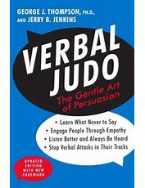
What is Verbal Judo?
“VERBAL JUDO: THE GENTLE ART OF PERSUASION” WRITTEN BY DR. GEORGE THOMPSON [PH.D.] AND FIRST PUBLISHED IN 1994.

Slide 17
10% of conflicts are due to a difference of opinion, 90% are due to wrong tone of voice

Slide 18
The Five Truths
1. All cultures want to be respected and treated with dignity, regardless of the situation.
2. All people would rather be asked than told what to do.
3. All people want to know why they are being asked or told to do something.
4. All people would rather have options than threats.
5. Finally, all people want a second chance to make matters right.

Slide 19
LEAPS
Listen
Empathize
Ask
Paraphrase
Summarize

Slide 20
Final Thought
Be A Leader
Not A Supervisor

Slide 21
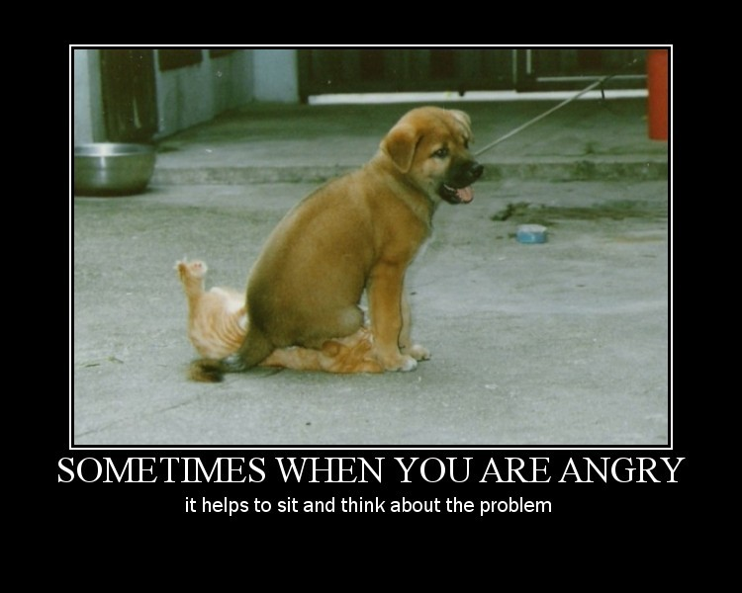
Conclusion

