Slide 1

The Secret Life of SMEs

Slide 2

What is a SME?
“¯\_(ツ)_/¯“
SUBJECT MATTER EXPERT
A SME is an individual with a deep understanding of a particular area or topic.
SMEs assist others in determining solutions to specific problems.
SMEs also support communicating knowledge within an organization.

Slide 3

Call SME, Maybe?
What do the SMEs do?
Answer functional questions
  How do I do this? Is this working correctly?
Process PSRs assigned to the SME Team
Work order support
Maintenance release support
User documentation
BCSE support and collaboration
Each County DRS has an assigned SME for support

Slide 4
Hello, is it SME you’re looking for?
Topics SMEs do not cover:
Decisions on Case Management or Case Processing
  SMEs answer “how to” or “is this working properly” questions
Policy or procedures questions
  BCSE’s Division of Program Development and Evaluation (DPDE)
    Program Development Section
    ra-DRSMemoInquiries@pa.gov
Administrative Questions (Audits, MSEs, Budget etc.)
  BCSE’s Division of Program Development and Evaluation (DPDE)
    Program Compliance Section or Program Administration Section
    ra-DRSFinancials@pa.gov
eCIS related questions or issues
  County eCIS Admin
  eCIS User Guide and Tips available on the Knowledge Directory
  DHS Program Office Contacts, Ray Scott at rayscott@pa.gov or Samantha Noone at snoone@pa.gov.

Slide 5
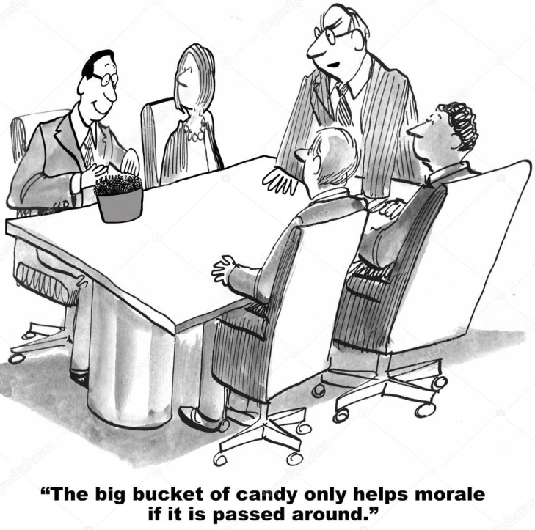
When a SME cannot answer your question, they will do their best to send you in the right direction to get the answer for which you are looking.

Slide 6
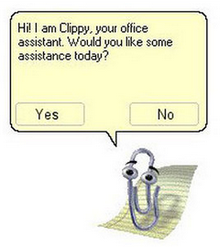
Examples of Other Resources
Other workers in your county
Other counties
IV-D Attorney or solicitor
Knowledge Directory
PACSETI
BCSE Divisions
PACSES Network Team
OCSE Website

Slide 7

Help!?
Commonly received questions…and their secret SME answers.
Just kidding, tell everyone!

Slide 8


Is it a bug?
Things to check:
Review user documentation available in the Knowledge Directory
Review Help in ePACSES/eQuate
Review bug lists
  PACSES Open Bug Report (PACSES Document Library/Publications/Current Bugs and Change requests)
  Open Tech Refresh 1.2 Bugs (WO-5032) (PACSES Document Library/Technology Refresh Suite)
Contact your SME
What to do if you think something may be a bug:
Obtain screenshots, error messages and message error logs
Submit a PSR to the PACSES Help Desk

Slide 9


Is it a bug? (continued)
Tips:
Screenshots
  Please include the entire application screen
    Alt+PrtScn and then Ctrl+V
    Snipping Tool
  Error Messages!!!
    Ensure that the entire error message is displayed in the screenshot
      Hover over red exclamation point
      Click on red exclamation point to get the full message to display in the red banner

Slide 10
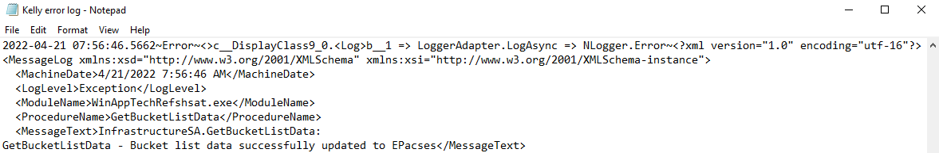
Is it a bug? (continued)
Error Message Log
  Provides details for the Application Team when researching ePACSES issues
  Instructions for locating the error log on a worker’s PC are in the Technology Refresh Suite (How to Capture the Error Log)
Bug status updates
  Ask your SME
  Bug/Change Request open discussion in PACSES Advisory Committee (PAC)

Slide 11
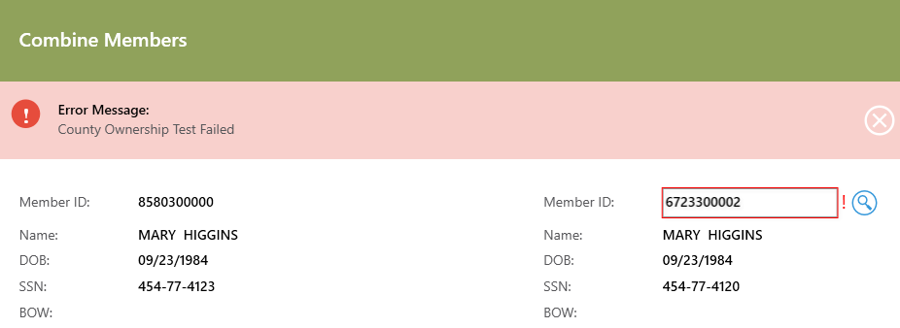
Errors Combining Members
Errors when combining duplicate members (CDUPing)
County Ownership error
  The county with the duplicate (bad) member should complete the CDUP using the Combine Members button on the Member Summary component for the other county’s member (the original [good] member).
  A worker cannot combine a member that is not owned by their county into another member.

Slide 12
Errors Combining Members (continued)
Cannot combine as member has active income withholding order.
  This message is received when the duplicate (bad) member has an active IWO.
  If the duplicate member has an SSN listed under Demographics: Change the status of the IWO to Closed in the member’s Income Withholding component. Combine the members. Add the employer associated with the IWO to the original (good) member’s Employment Information component if necessary.
  If the duplicate member does not have an SSN listed under Demographics: End date the employer in the Employment Information component. Allow batch to run so that the IWO becomes inactive. Combine the members. Add the employer associated with the IWO to the original (good) member’s Employment Information component if necessary.

Slide 13
Errors Combining Members (continued)
Other tips to remember:
When the duplicate member is a defendant, review any payments on hold, and reverse or release them prior to combining.
When the duplicate member is a plaintiff, make sure any check recipient information on OCKR is updated to the member ID for the original member.
When the duplicate member is a child, update any debt types on OBLE to the original member ID after combining.
If both the original and duplicate members are active on TANF, the DRS should call the local County Assistance Office (CAO) and/or their DFO representative, as this could be a potential fraud issue. One of the members has to be closed on TANF before they can be combined.
The Combining Duplicate Members User Guide is available in the Knowledge Directory.

Slide 14
Intergovernmental Agency Address Updates
Intergovernmental Agency Address Updates
For most states, the addresses in ePACSES associated with specific locator codes are updated when the other state updates their information on the Intergovernmental Reference Guide (IRG). Only certain situations require BCSE to manually update an address for a locator code.
The IRG interfaces with ePACSES twice a month (2nd and 17th).
When a worker receives notice from another state agency that their address has changed, check to see if the update has been automatically received in ePACSES through the interface.
If the update was not made automatically, submit a PSR with a copy of correspondence on letterhead from the other state indicating that their address has changed.
Use the override address function in ePACSES in the interim.

Slide 15
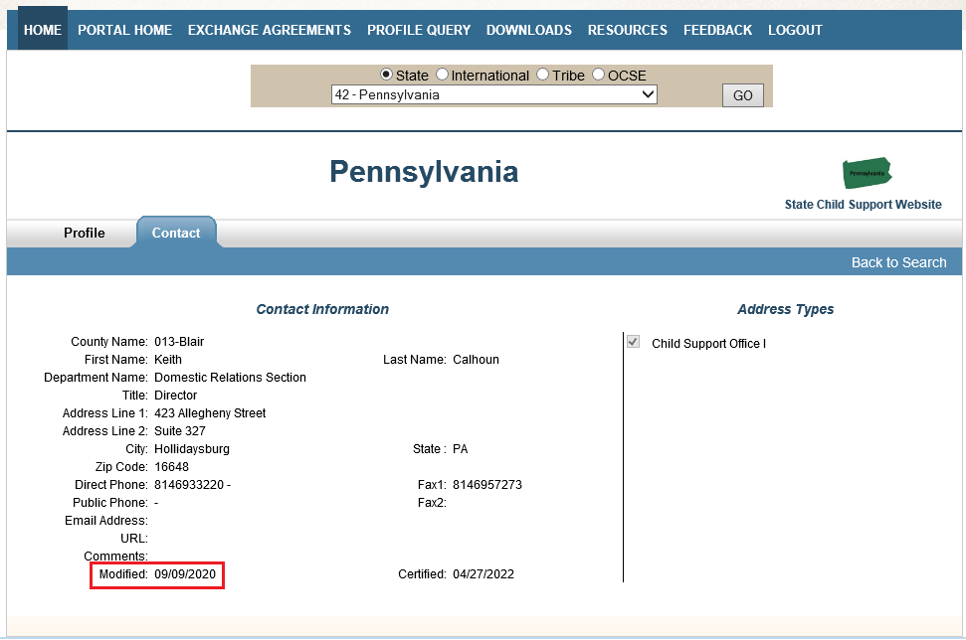
Intergovernmental Agency Address Updates (continued)
Example of Contact Information on the IRG:

Slide 16
To DPSR, or not to DPSR?
Does this require a Data Processing Service Request (DPSR)?
Is it available on a report in Data Warehouse?
  Example: List of cases where the total balance is a negative number (overpaid) – Export the R620 to Excel and sort by Total Case Balance column (smallest to largest).
Is it available through a Case Dashboard filter?
  Example: List of cases with upcoming emancipation – Using the “Child Emancipation Date” filter a worker is able to select a date range for the emancipation, and the results are displayed on the Case Dashboard.
  Use Projects module to generate a spreadsheet if necessary.

Slide 17
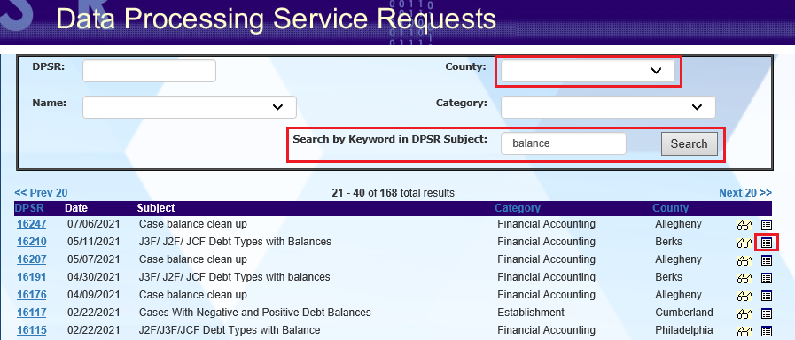
To DPSR, or not to DPSR? (continued)
Be nosy! Check the DPSR database to see if results have been provided for a similar request filed by someone else.

Slide 18
Agency Case Setup
What does this message mean?!!
This message usually means that one or both of the following is true for the case in question:
The incorrect child support debt type was used on OBLE.
  Usually occurs when the CSA debt type is used instead of CFA, JUV or FCX (only used for a child in IV-E Foster Care that is placed in a Psychiatric Residential Treatment Facility).
  Why is this incorrect?
    It may result in the Annual Federal User Fee being inappropriately collected.

Slide 19
Agency Case Setup (continued)
Child support accrued in the incorrect bucket (Non-TANF/Family instead of FC IV-E, NFFC IV-E or Title XIX) which is driven by the child’s IV-A/IV-E status.
  Usually occurs when the child’s IV-A/IV-E status is not updated to Foster Care or Non-Federal Foster Care immediately upon creating or reopening an agency case.
  Why is this incorrect?
    It impacts the type of collections that are reported for reimbursement purposes.
  Workers may need to review eCIS for additional details on the child’s placement and/or contact the filing agency for more information if necessary.
  If the child’s existing IV-A/IV-E status is TANF, contact your Division of Field Operations (DFO) Specialist for assistance.
The IV-E/Non IV-E Case Processing Desk Reference is available in the Knowledge Directory to assist with setting up agency cases.

Slide 20
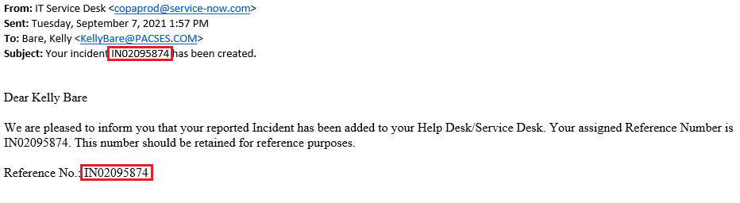
PSR Status Requests
PSR Status Requests
PSRs get routed to a number of different places (SMEs, PACSES Network, BCSE, etc.) once they are entered into our incident management system by the PACSES Help Desk.
For an update on the status of your request, it is best to email the PACSES Help Desk (with your incident number, if possible) so that they can look up the request and reach out to whomever it is assigned for an update.
HelpDeskTeam@PACSES.com

Slide 21

Questions???

Slide 22
Resources
Knowledge Directory
  User Guides
  DPRs
  Directory
    ePACSES > General Information > Directory
    DFO, BCSE, SME, SCDU
    PACSETI
      Training
      PACSETI Instructors
      Child Support Program Manual (CSPM)
      Memos, BIMs
      OCSE Website

Slide 23
Documents Referenced
County Assigned SME
BCSE Directory
Elements Required for PSR Processing
PACSES Tips
PACSES Open Bug Report
Open Tech Refresh Bugs 1.2
How to Capture the Error Log
Combining Duplicate Members User Guide
IV-E/Non IV-E Case Processing Desk Reference

Slide 24
Contact Information
Jessica Moyer
  jessicamoyer@pacses.com
  717-782-0148
Kelly Bare
  kellybare@pacses.com
  717-782-0142

